Slide 1

Demand forecasting
105-05
Lummetry.AI

Slide 2

What is demand forecasting?
It’s the process of making future estimations for services/products in relation to customer demand
over a specific period. Demand forecasting makes use of historical sales data.
The resulting estimates include critical business metrics for the future: turnover, profit margins, cash flow, operational expenses, capital expenses, risk assessment and mitigation plans, capacity planning etc.
Demand forecasting 101 - DS105

Slide 3

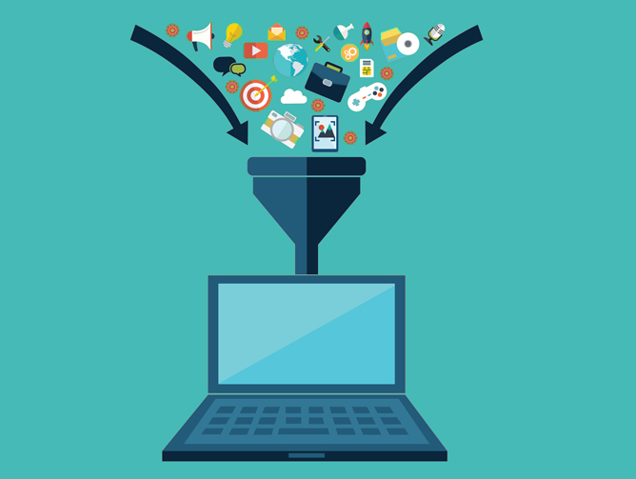
Demand forecasting techniques
Qualitative
Quantitative
Statistical and generally automated (computer-aided) research
Human-focused research
Demand forecasting 101 - DS105

Slide 4
Business value
Short- (1 to 6 months) as well as mid-,and long-term (6+ months) estimates are used for:
Pre-building
Make-to-stock
Make-to-order
Contract manufacturing
Supply planning
Network balancing
…
Demand forecasting 101 - DS105

Slide 5
The qualitative approach
Uses the expertise of market research experts, sales/purchase/operations teams.
Long term
Qualitative
demand forecasting
Biased towards specific products/services
Based on the expert’s area of expertise
Highly granular
Demand forecasting 101 - DS105

Slide 6
The quantitative approach
Quantitative techniques that use and apply statistical methods:
Static forecasting: average of historical data based on relevant business historical data
Trend projection: uses advanced statistical methods to project trends: moving averages and least-square methods
Barometric (econometric) forecasting: uses macro-economic models to project high-granularity and potential long-term forecasts (similar and closely related to qualitative analysis but based on macroeconomic data)
Demand forecasting 101 - DS105

Slide 7
Commonly used methods for quantitative analysis
Simple static forecasting by averaging historical data
Advanced static forecasting with weighted averages (i.e., combining average weekly sales over the last month with average weekly sales in the last year)
Advanced static forecasting with weighted averages and re-adjusted based on experts’ opinion (after computing the static forecast, a purchase/sales expert adjusts it based on their personal opinion (or bias))
Demand forecasting 101 - DS105

Slide 8
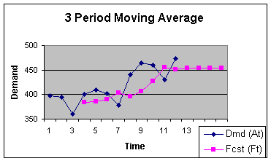
Trend projection
Trend projection based on moving averages
Picture courtesy of fcgu.edu
Demand forecasting 101 - DS105

Slide 9
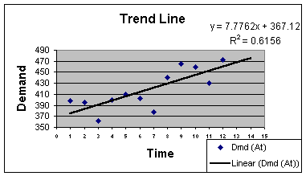
Trend projection
Trend projection based on least squares (basic ML)
Picture courtesy of fcgu.edu
Demand forecasting 101 - DS105

Slide 10

Classic demand forecasting: pros & cons
The logic is simple so the business user can relate to the logic of the predictions
Almost impossible to generate patterns unless the trend is extremely predictable (such as a weekend-only sold item)
Demand forecasting 101 - DS105

Slide 11
Advanced demand forecasting: pros & cons
Use advanced models to ingest exogenous data (such as promotions or weather) that can be used for A/B testing
Almost invariably outperform classic approaches for any kind of use-case
Expensive to build and maintain
Explainability is (almost) zero - generally seen as “black-boxes”
Demand forecasting 101 - DS105

Slide 12
How to choose what’s best?
1 - Start from your data - manual or automatic analysis
Understand your business process objectives and requirements including but not limited to:
Final objective (e.g., replenishment, marketing sensitivity simulation)
Aggregation levels (e.g., day, week)
Endogenous (e.g., date, time, quantity sold yesterday) and exogenous variables (e.g. weather, promotion)
…
Demand forecasting 101 - DS105

Slide 13
How to choose what’s best?
2 - If you already have predictions then you could skip to the next step...
.. however if you don’t have predictions or an existing forecasting model you have to analyze what fits you best:
Multi-level averages (most likely already implemented… if so, skip to the next step)
Linear models (most likely the best candidate)
Moving averages
…
Demand forecasting 101 - DS105

Slide 14
How to choose what’s best?
3 - Adopt the explainable approaches that you already have at hand?
Usually medium and large business are using statistical based heuristics that they already employed in previous years/periods
Demand forecasting 101 - DS105

Slide 15
How to choose what’s best?
4 - Establish a test base - what to consider history and what is (known) future?
If the backlog data (history) is too long it might not be relevant to current trends (see pre and post COVID-19)
If the backlog data is too short then some methods are inapplicable (e.g., you can’t predict yearly seasonality with 6 months of data)
Select what “past” means (real data that is available to all methods) and what is designated as “future” (real historical data that is kept private)
Demand forecasting 101 - DS105

Slide 16
How to choose what’s best?
5 - Apply your adopted explainable approach and generate forecasts
At this stage, you have a couple of options:
Get data from ERP systems if it already exists for “future” historical data (not the real backlog but rather the forecasts generated at that time such as order quantities)
Re-run your heuristics/models using “past” data and generate “future” values
Demand forecasting 101 - DS105

Slide 17
Classic or advanced: how to choose what’s best?
6 - Use the advanced techniques to generate advanced forecasts
Feed the “past” in the advanced models (such as Deep Learning models) and obtain the predicted “future”
Get several “opinions” (multiple models) each with its pros and cons such as speed vs accuracy
Demand forecasting 101 - DS105

Slide 18
Classic or advanced: how to choose what’s best?
7 - Compare both classic and advanced results vs reality and judge
Step by step including average error and visual comparison
Step by step can mean hour by hour, day by day, week by week etc.
Analyze each autoregressive step and compare with baseline as well as reality
Visually compare by overlapping predictive steps of both models with reality
Almost impossible to “guess” the right answer
Demand forecasting 101 - DS105

Slide 19
Classic or advanced: how to choose what’s best?
7 - Compare both classic and advanced results vs reality and judge
Period-based amount comparison and error measurement
Useful when step prediction is not that important but the aggregated one is vital for the business
Aggregate all predicted steps and analyze the result vs baseline vs reality
More prone to miss-judgments than step-by-step and requires multiple tests
Demand forecasting 101 - DS105

Slide 20

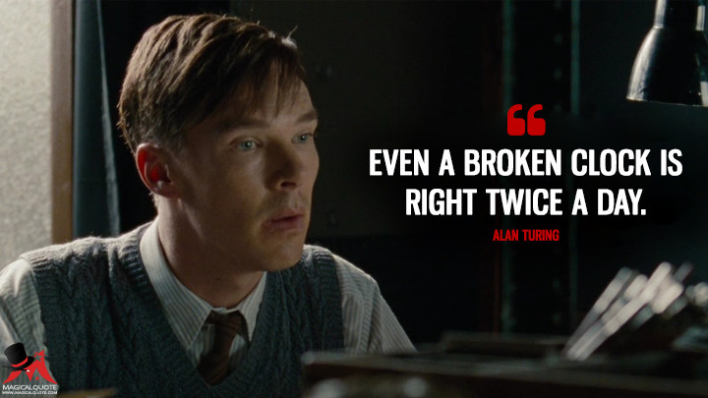
Setting the right expectations
Glorified random number generators
Truly intelligent models
Demand forecasting 101 - DS105

Slide 21
Critical failures of AI in 2022
Data drift
Concept drift
Changing requirements
Demand forecasting 101 - DS105

Slide 22
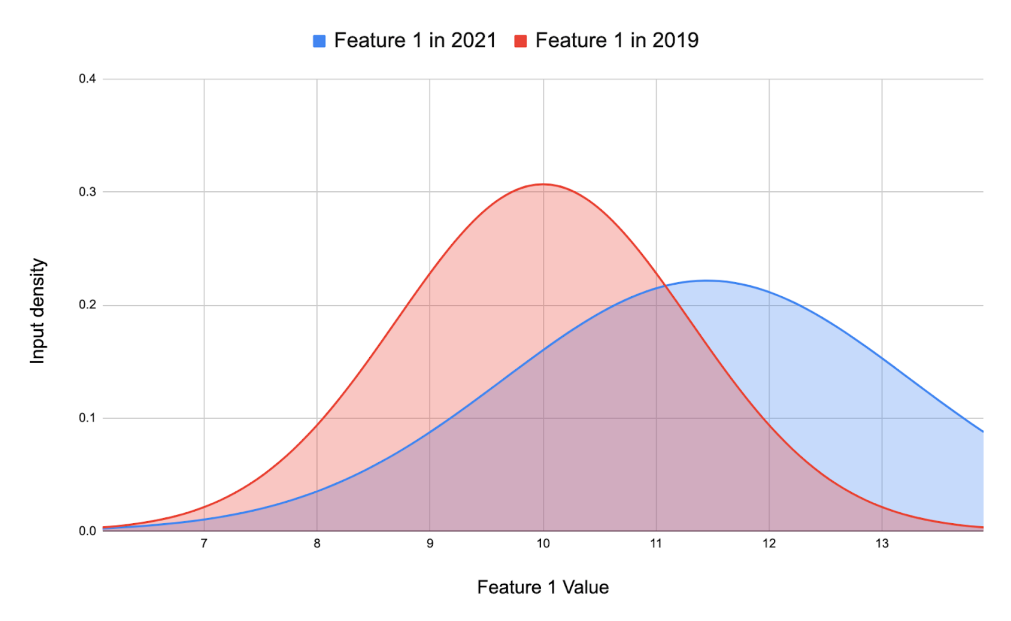
Critical failures of AI in 2022: data drift
The model was trained on a certain distribution of inputs, but this distribution changes over time. For example, let’s imagine we trained a model to estimate demand for electricity from historical data, but climate change is causing unprecedented changes to weather, so the model’s accuracy degrades. See COVID-19.
Figure source
Demand forecasting 101 - DS105

Slide 23
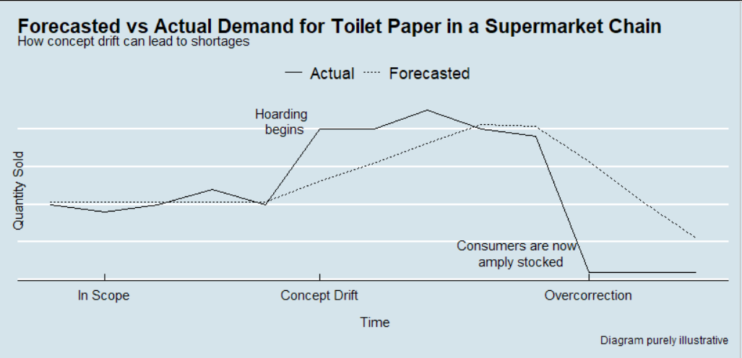
Critical failures of AI in 2022: concept drift
The model was trained to learn an x->y mapping such as to predict the time to unload an automatic delivery box based on data, location, sex and age of customer, but the statistical relationship between x and y changes, so the same input x now demands a different prediction y - such that we need the actual time of the day when the customer will unload. For example, a model that predicts housing prices based on square footage will lose accuracy as inflation causes prices to rise.
Figure source
Demand forecasting 101 - DS105

Slide 24
Critical failures of AI in 2022: changing reqs
The model was built to perform a particular task, but the product team decides to modify its capabilities. For instance, a model detects construction workers who wander into a dangerous area without a hard hat for more than 5 seconds. But safety requirements change, and now it must flag hatless workers who enter the area for more than 3 seconds. This issue sometimes manifests as concept drift, but we put it in a different category because it’s often driven by changes in product specifications rather than changes in the real world.
Demand forecasting 101 - DS105

Slide 25
Measuring the impact
Last but not least - measuring the impact with actual business perspective
More qualitative and less quantitative
Different from use-case to use-case for the same class of models
Simple questions might not always be enough:
How much did I save on locked-up funds due to less over-stocks?
How much did I gain by stocking-up and selling more?
Demand forecasting 101 - DS105

Slide 26
Thank you!
Demand forecasting 101 - DS105

